Slide 1

WHERE TO DRAW A LINE??
Line drawing is accomplished by calculating intermediate positions along the line path between specified end points.
Precise definition of line drawing
    Given two points P and Q in the plane, both with integer coordinates, determine which pixels on a raster screen should be on in order to make a picture of a unit-width line segment starting from P and ending at Q.

Slide 2
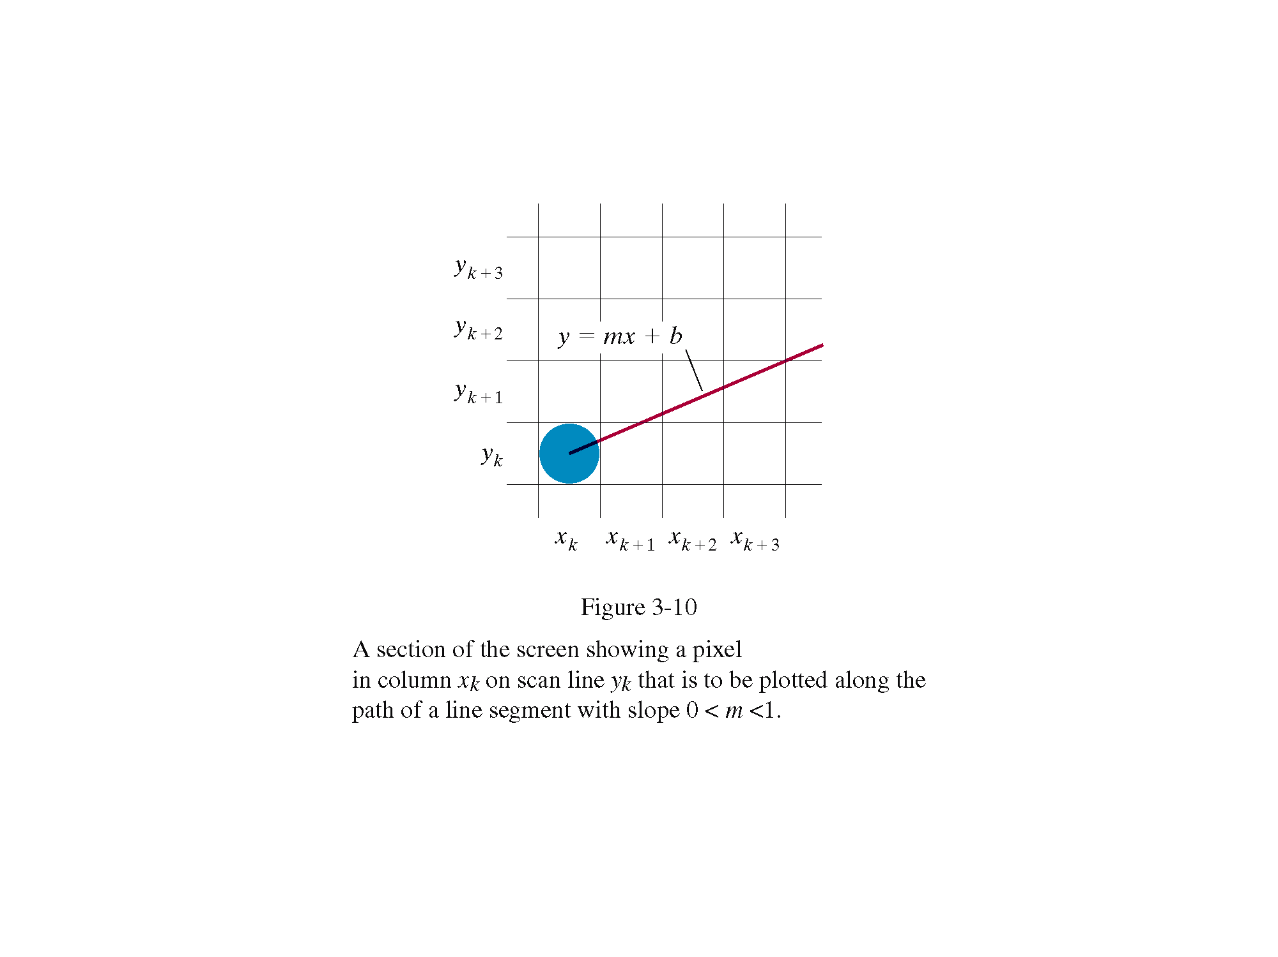
6
(3, 3)
5
4
3
2
1
0
0 1 2 3 4 5 6

Slide 3
Line drawing (cont)
The thinnest line is of one-pixel wide. We will concentrate on drawing a line of 1 pixel resolution.
The Cartesian slope-intercept equation for a straight line is
y= m. x + b ------ Eqn. 1
m is the slope of the line and b is the y intercept.
Given the endpoints of a line segment.
m = y2-y1 / x2-x1 ------ Eqn. 2
b= y1-m.x1 -------- Eqn. 3

Slide 4
Line Drawing (cont)
Also for any given interval ∆x along a line, we can compute the corresponding y interval ∆y from
∆y= m. x
Similarly we can obtain the x interval ∆x corresponding to a specified ∆y as
  ∆x= ∆y / m
These equations form the basis for determining deflection voltages in analog devices.

Slide 5
Line Drawing (cont)
Also , for any given x interval ∆x along a line, we can compute the corresponding y interval ∆y from
      ∆y= m. ∆ x
These equations form the basis for determining deflection voltages in analog devices.
On Raster systems, lines are plotted with pixels, and step sizes in the horizontal and vertical directions are constrained by pixel separations. Hence we ought to “sample” a line at discrete positions and determine the nearest pixel to the line at each sampled position.

Slide 6
Symmetry
If we could draw lines with positive slope (0<=slope<=1) we would be done.
  For a line with negative slope (0>=slope>=-1)
    We negate all Y values
  For a line with slope > 1 or slope <-1
    we just swap x and y axes
(-y,x)
(y,x)
(x,-y)
(x,y)
45⁰
(-x,-y)
(x,-y)
(-y,-x)
(y,-x)

Slide 7
Code for drawing a line
……….
If(0 <= slope <= 1)
draw_fn= draw_pixel
draw_lne(Px, PY, QX, QY, draw_fn)
Else if (-1 <= slope <= 0)
draw_fn = invert_y_draw
Draw_line(PX, -PY, QX, -QY, draw_fn)
Else if (1 < slope)
draw_fn= swap_xy_draw
Draw_line(PY,PX,QY,QX)
Else
Draw_fn=swap_xy_invert_y_draw
Draw_line(-PY,PX,QY,-QX, draw_fn)
Invert_y_draw(int x,int y)
draw_pixel(x,-y)
Swap_xy_draw(int x,int y)
draw_pixel(y,x)
Swap_xy_invert_y_draw(int x,int y)
draw_pixel(y,-x)

Slide 8
DDA ALGORITHM
The digital differential analyzer (DDA) samples the line at unit intervals in one coordinate corresponding integer values nearest the line path of the other coordinate.
The following is thus the basic incremental scan-conversion(DDA) algorithm for line drawing
for x from x0 to x1
Compute y=mx+b
Draw_fn(x, round(y))
Major deficiency in the above approach :
  Uses floats
  Has rounding operations

Slide 9
DDA Illustration
Desired Line
(x_{i}+1, Round(y_{j}+m))
(x_{i}, y_{j})
(x_{i}+1, y_{j}+m)
(x_{i}, Round(y_{j}))
y2
y1
x1
x2

Slide 10
Bresenham’s Line Algorithm
An accurate, efficient raster line drawing algorithm developed by Bresenham, scan converts lines using only incremental integer calculations that can be adapted to display circles and other curves.
Keeping in mind the symmetry property of lines, lets derive a more efficient way of drawing a line.
  Starting from the left end point (x₀,y₀) of a given line , we step to each successive column (x position) and plot the pixel whose scan-line y value closest to the line path
  Assuming we have determined that the pixel at (x_{k},y_{k}) is to be displayed, we next need to decide which pixel to plot in column x_{k+1}.

Slide 11
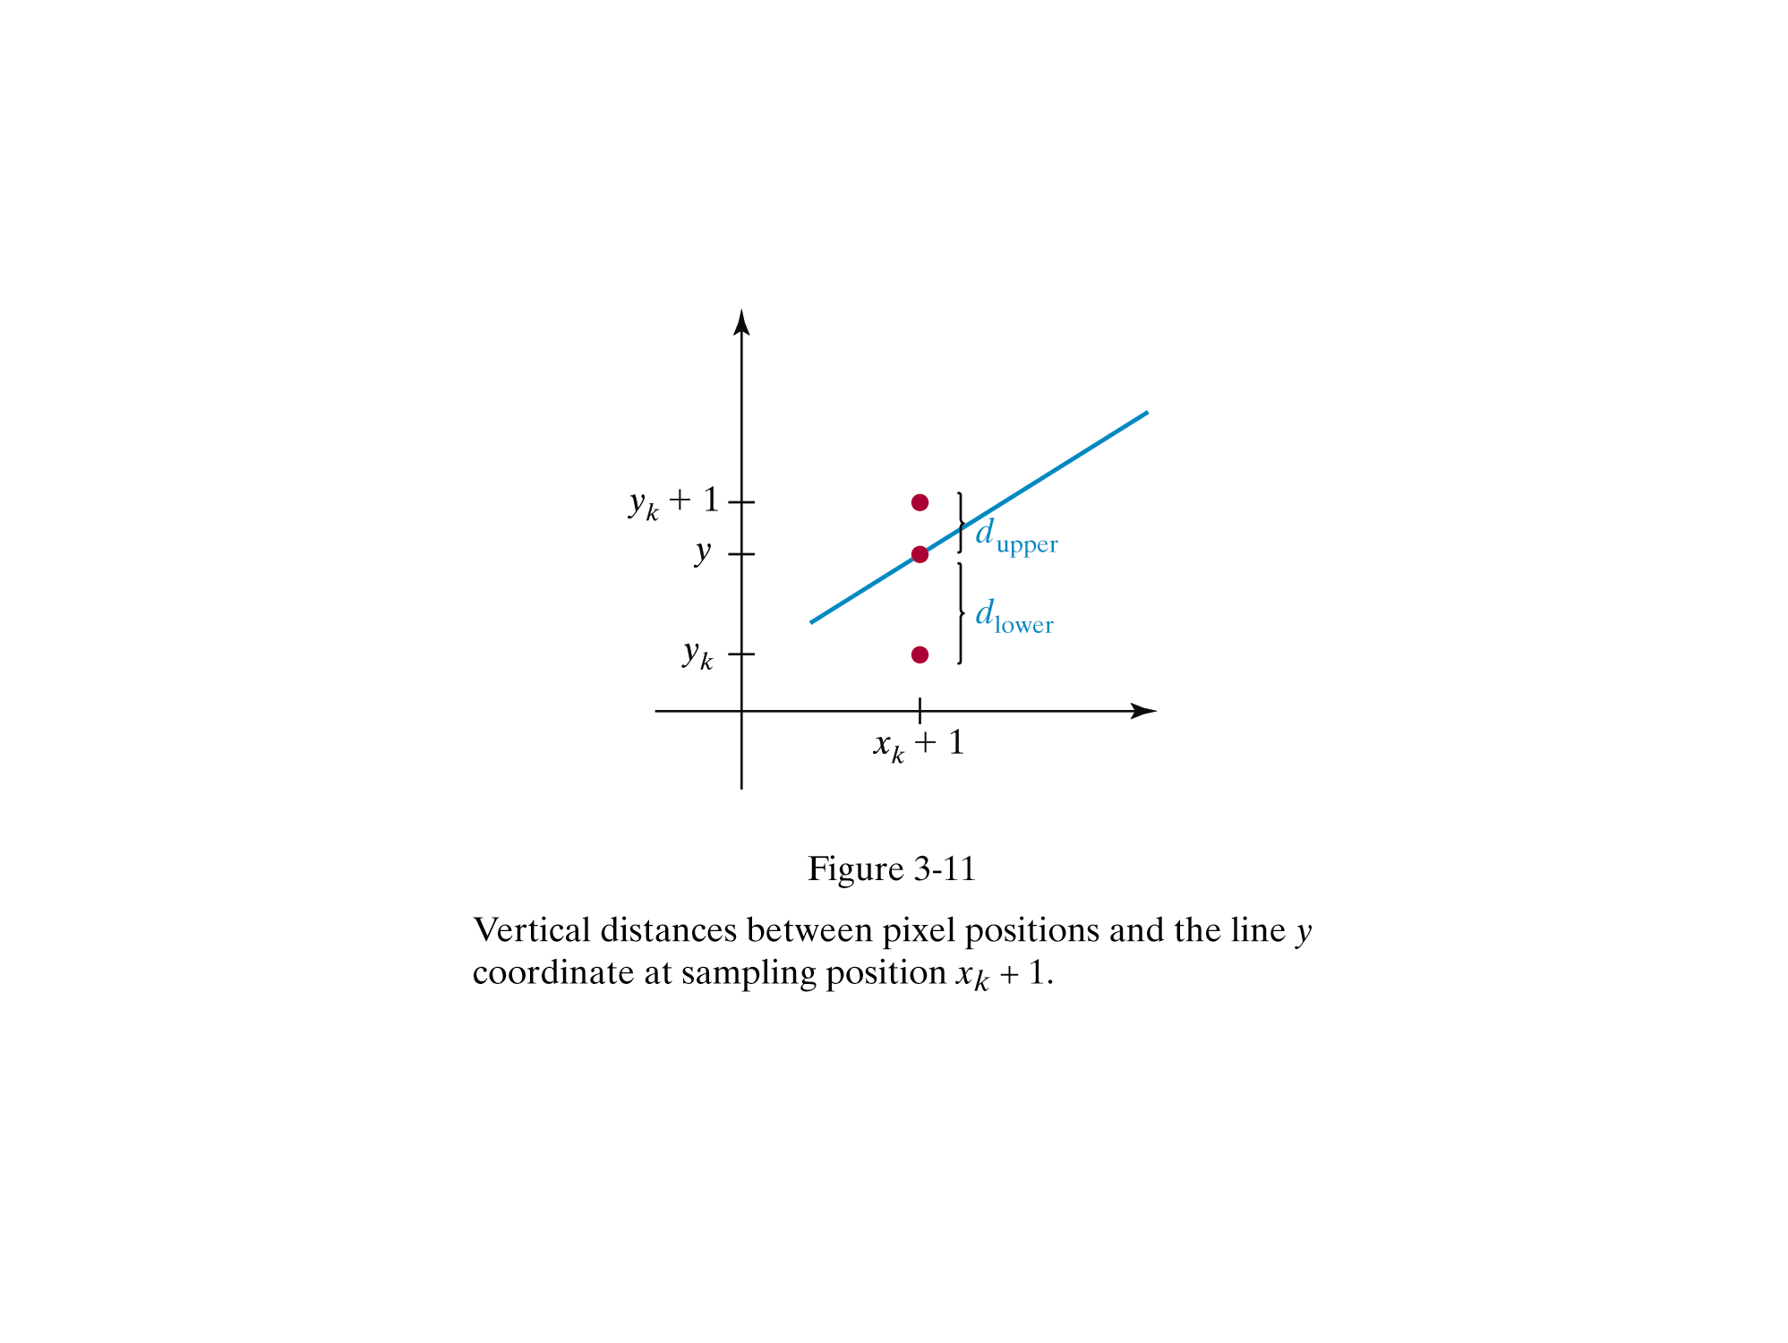

Slide 12
Bresenham Line Algorithm (cont)
Choices are(x_{k} +1, y_{k}) and (x_{k}+1, y_{K}+1)
d₁ = y – y_{k} = m(x_{k} + 1) + b – y_{k}
d₂ = (y_{k} + 1) – y = y_{k} + 1- m(x_{k} + 1) – b
The difference between these 2 separations is
A decision parameter p_{k} for the k^{th} step in the line algorithm can be obtained by rearranging above equation so that it involves only integer calculations
d1-d2 = 2m(xk + 1) – 2 yk + 2b – 1

Slide 13
Bresenham’s Line Algorithm
Define
P_{k} = Δx ( d₁-d₂) = 2Δyx_{k}-2 Δxy_{k} + c
The sign of P_{k} is the same as the sign of d₁-d₂, since Δx > 0.
Parameter c is a constant and has the value 2Δy + Δx(2b-1)
(independent of pixel position)
If pixel at y_{k} is closer to line-path than pixel at y_{k} +1
(i.e, if d₁ < d₂) then p_{k} is negative. We plot lower pixel in such a case. Otherwise , upper pixel will be plotted.

Slide 14
Bresenham’s algorithm (cont)
At step k + 1, the decision parameter can be evaluated as,
p_{k}+1 = 2Δyx_{k}+1 - 2Δxy_{k}+1 + c
Taking the difference of p_{k+ 1} and p_{k} we get the following.
p_{k+1} – p_{k} = 2Δy(x_{k+1}- x_{k})-2Δx(y_{k+1} – y_{k})
But, x_{k+1} = x_{k} +1, so that
p_{k+1} = p_{k} + 2Δy - 2 Δx(y_{k+1} – y_{k})
Where the term y_{k+1}-y_{k} is either 0 or 1, depending on the sign of parameter p_{k}

Slide 15
Bresenham’s Line Algorithm
The first parameter p₀ is directly computed
p₀ = 2 Δyx_{k} - 2 Δxy_{k} + c = 2 Δyx_{k} – 2 Δy + Δx (2b-1)
Since (x₀,y₀) satisfies the line equation , we also have
y₀ = Δy/ Δx * x₀ + b
Combining the above 2 equations , we will have
p₀ = 2Δy – Δx
The constants 2Δy and 2Δy-2Δx are calculated once for each time to be scan converted

Slide 16
Bresenham’s Line Algorithm
So, the arithmetic involves only integer addition and subtraction of 2 constants
Input the two end points and store the left end point in (x_{0,}y₀)
Load (x₀,y₀) into the frame buffer (plot the first point)
Calculate the constants Δx, Δy, 2Δy and 2Δy-2Δx and obtain the starting value for the decision parameter as
p₀ = 2Δy- Δx

Slide 17
Bresenham’s Line Algorithm
At each x_{k} along the line, starting at k=0, perform the following test:
If p_{k} < 0 , the next point is (x_{k}+1, y_{k}) and
p_{k+1} = p_{k} + 2Δy
Otherwise
Point to plot is (x_{k}+1, y_{k}+1)
p_{k+1} = p_{k} + 2Δy - 2Δx
Repeat step 4 (above step) Δx times

Slide 18
Where do we draw a circle???
Properties of a circle:
A circle is defined as a set of points that are all the given distance (x_{c},y_{c}). This distance relationship is expressed by the pythagorean theorem in Cartesian coordinates as
(x – x_{c})² + (y – y_{c}) ² = r²
We could use this equation to calculate the points on the circle circumference by stepping along x-axis in unit steps from x_{c}-r to x_{c}+r and calculate the corresponding y values at each position as
y = y_{c} +(- ) (r² – (xc –x )²)^{1/2}
This is not the best method:
  Considerable amount of computation
  Spacing between plotted pixels is not uniform

Slide 19
Polar co-ordinates for a circle
We could use polar coordinates r and θ,
x = x_{c} + r cosθ y = y_{c} + r sinθ
A fixed angular step size can be used to plot equally spaced points along the circumference
A step size of 1/r can be used to set pixel positions to approximately 1 unit apart for a continuous boundary
But, note that circle sections in adjacent octants within one quadrant are symmetric with respect to the 45 deg line dividing the to octants
Thus we can generate all pixel positions around a circle by calculating just the points within the sector from x=0 to x=y
This method is still computationally expensive

Slide 20
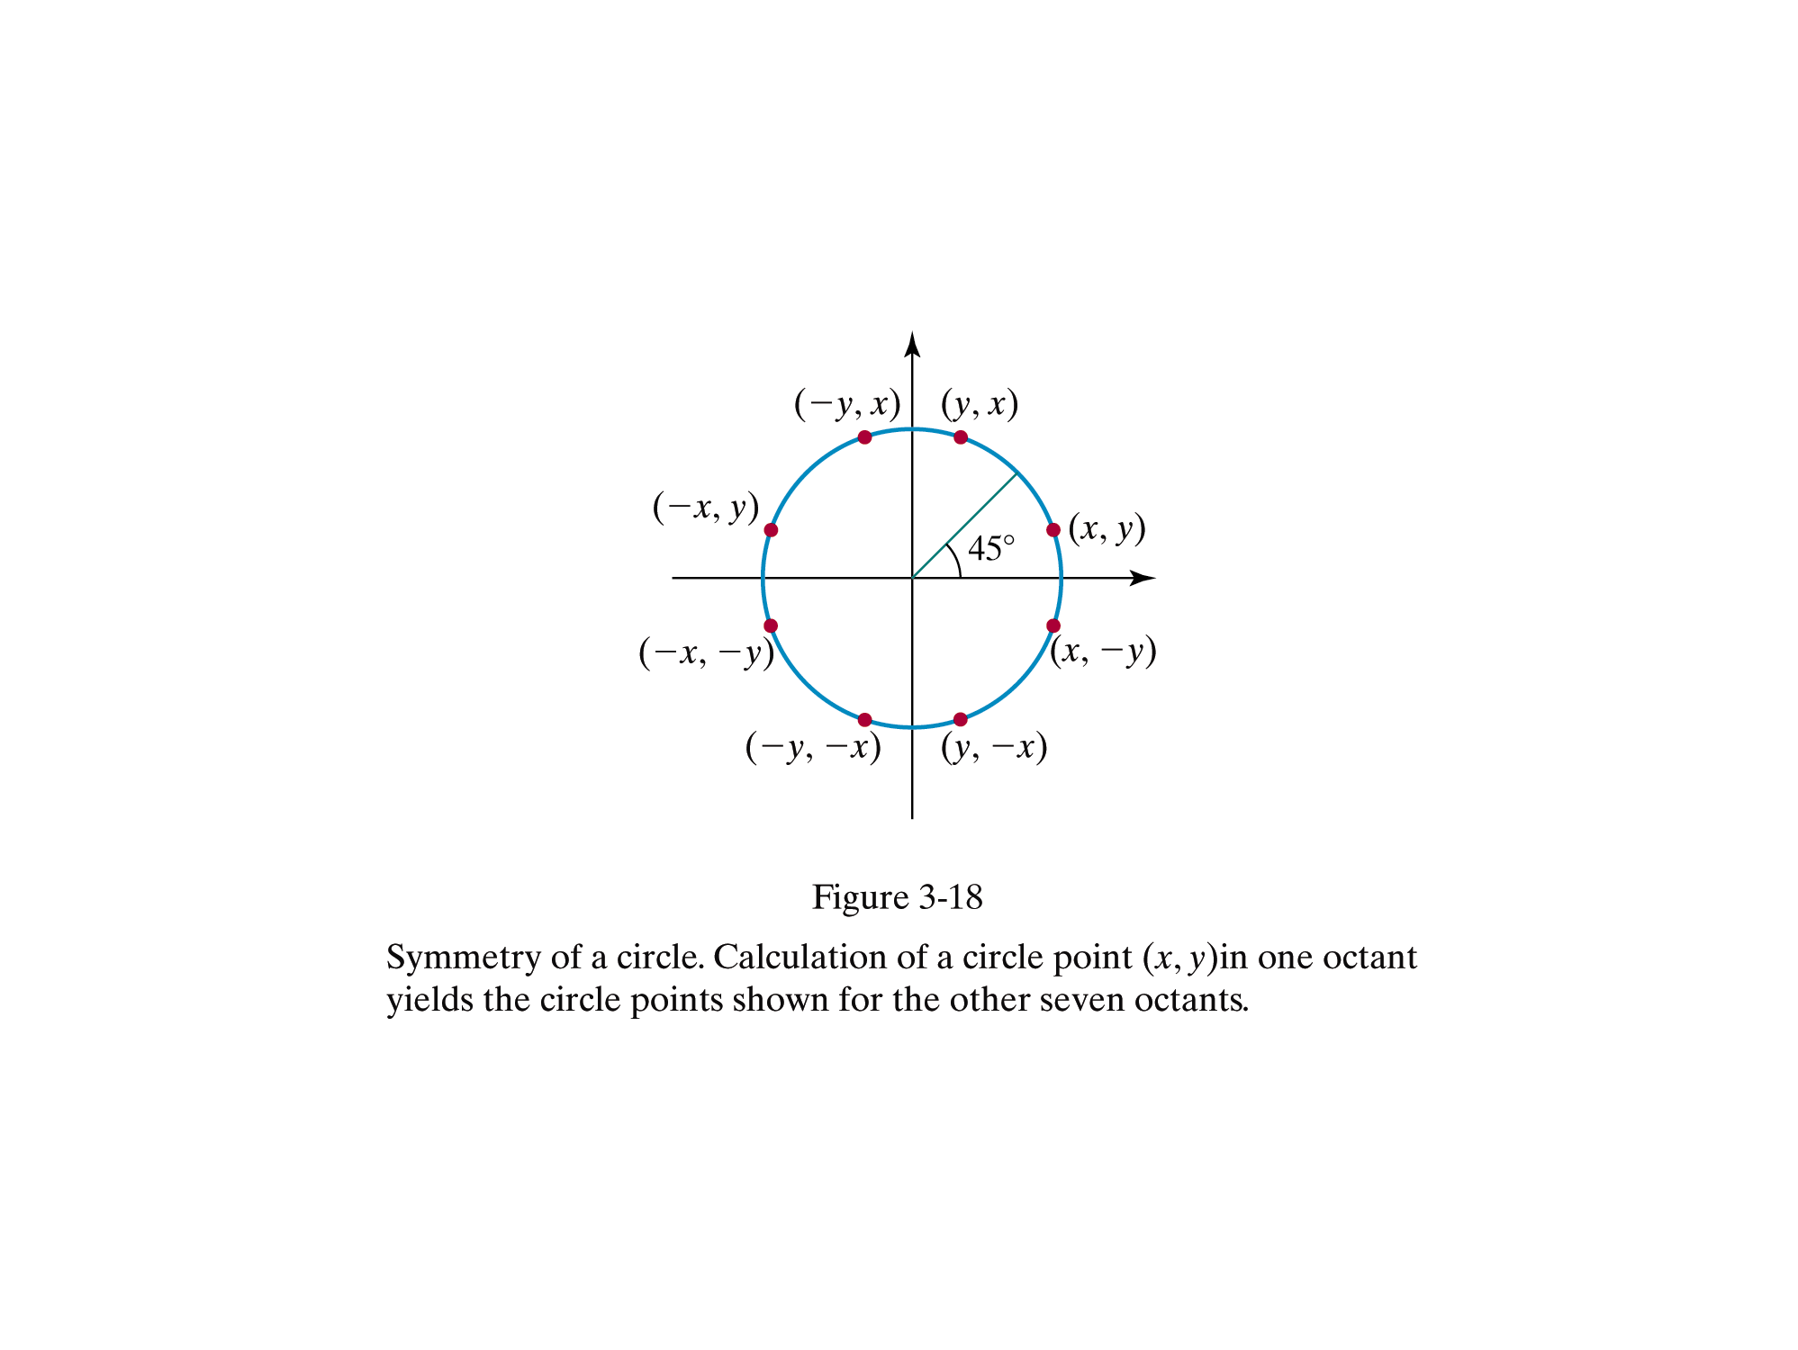

Slide 21
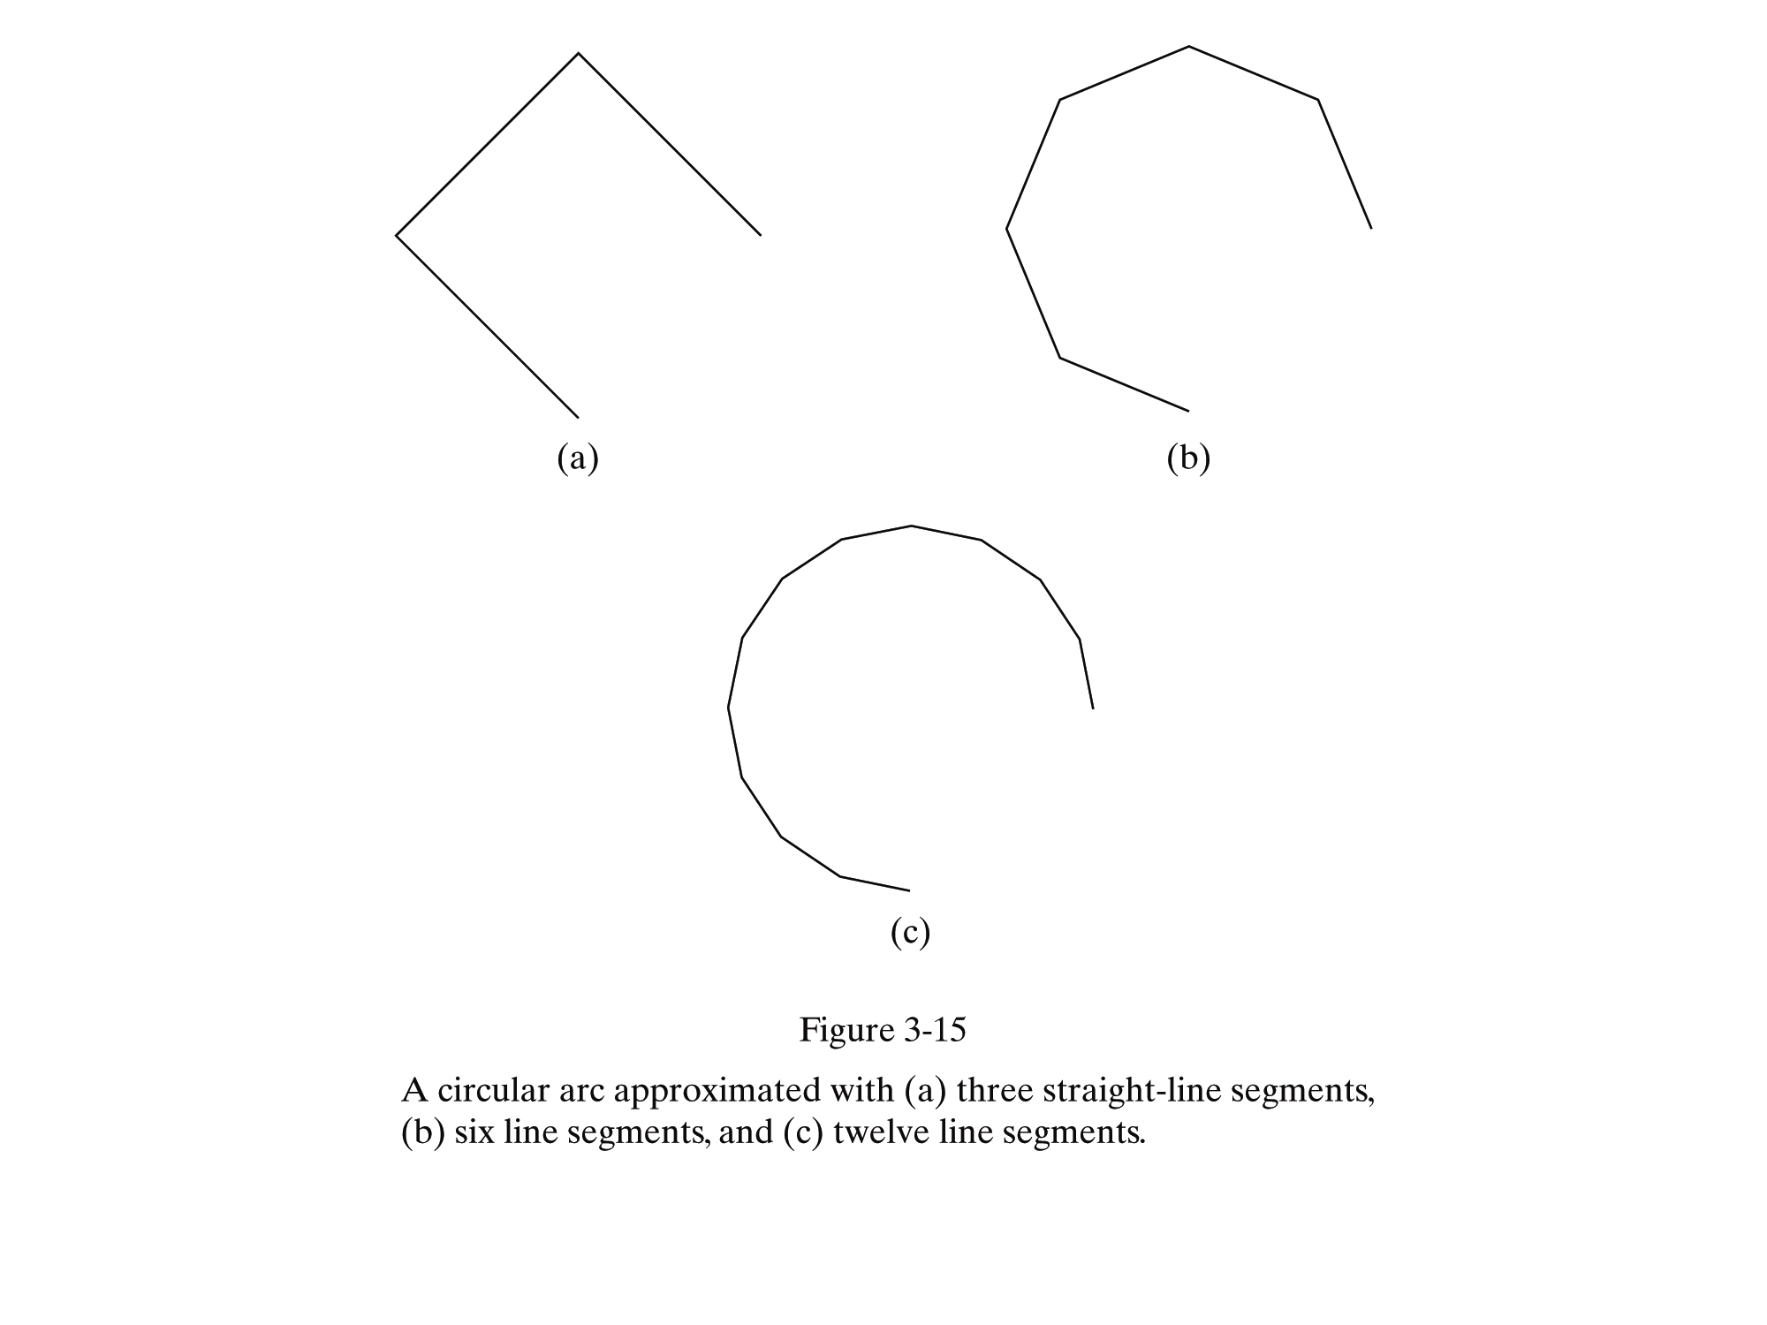

Slide 22
Bresenham to Midpoint
Bresenham requires explicit equation
  Not always convenient (many equations are implicit)
  Based on implicit equations: Midpoint Algorithm (circle, ellipse, etc.)
  Implicit equations have the form F(x,y)=0.

Slide 23
Midpoint Circle Algorithm
We will first calculate pixel positions for a circle centered around the origin (0,0). Then, each calculated position (x,y) is moved to its proper screen position by adding xc to x and yc to y
Note that along the circle section from x=0 to x=y in the first octant, the slope of the curve varies from 0 to -1
Circle function around the origin is given by
fcircle(x,y) = x² + y² – r²
Any point (x,y) on the boundary of the circle satisfies the equation and circle function is zero

Slide 24
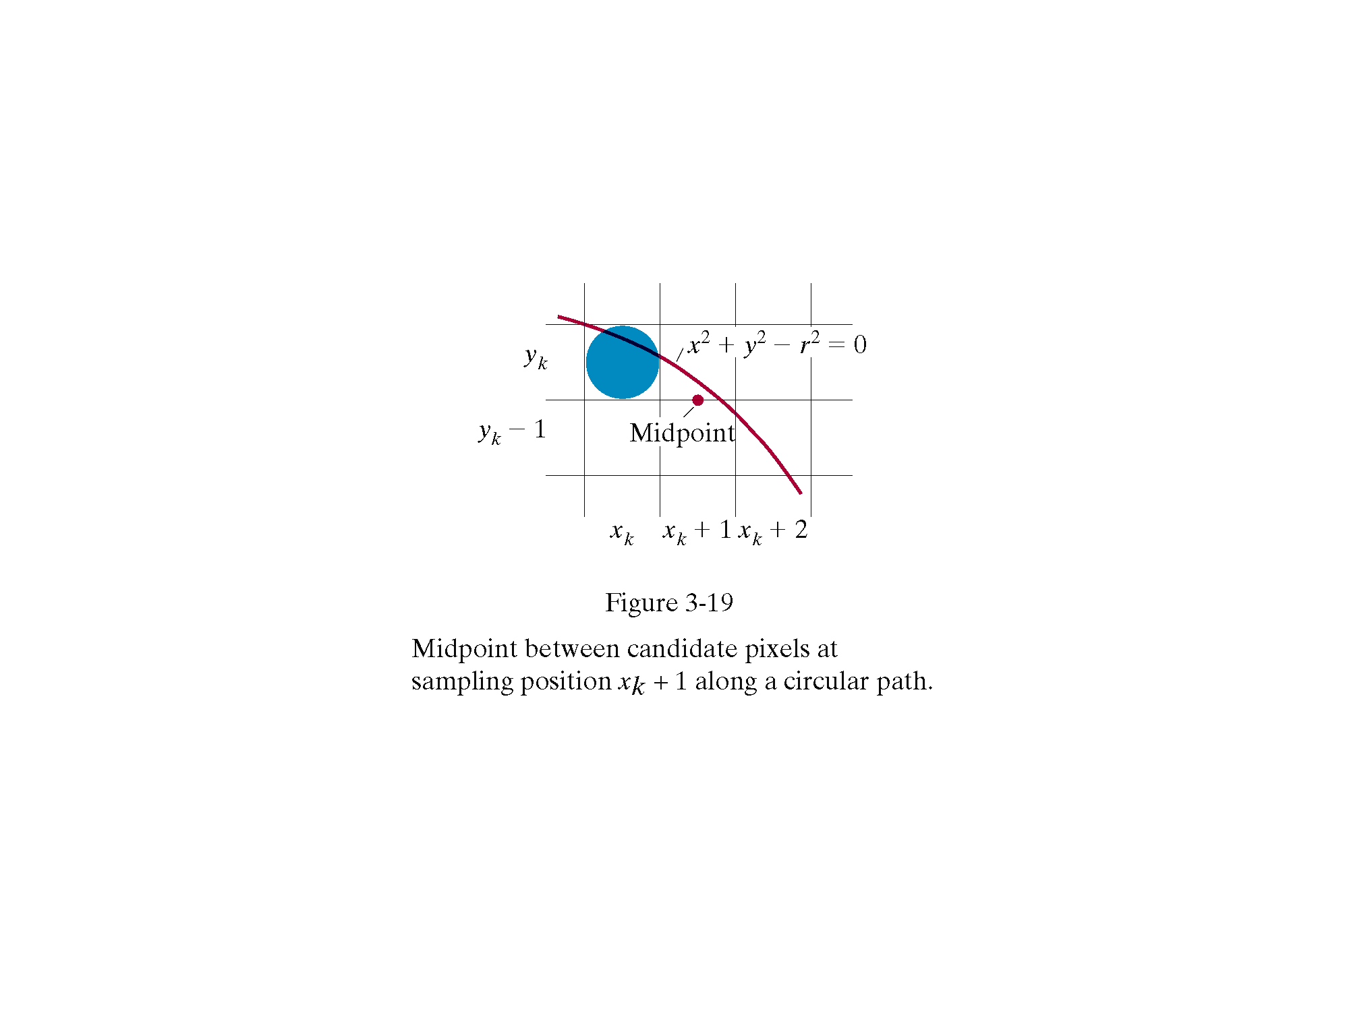

Slide 25
Midpoint Circle Algorithm
For a point in the interior of the circle, the circle function is negative and for a point outside the circle, the function is positive
Thus,
  f_{circle}(x,y) < 0 if (x,y) is inside the circle boundary
  f_{circle}(x,y) = 0 if (x,y) is on the circle boundary
  f_{circle}(x,y) > 0 if (x,y) is outside the circle boundary
yk
X²+y²-r²=0
Yk-1
Midpoint between candidate pixels at sampling position x_{k}+1 along a circular path
Midpoint
xk
xk+1
Xk+3

Slide 26
Midpoint Circle Algorithm
Assuming we have just plotted the pixel at (x_{k},y_{k}) , we next need to determine whether the pixel at position (x_{k} + 1, y_{k}-1) is closer to the circle
Our decision parameter is the circle function evaluated at the midpoint between these two pixels
p_{k} = f_{circle} (x_{k} +1, y_{k}-1/2) = (x_{k} +1)² + (y_{k} -1/2)² – r²
If p_{k} < 0 , this midpoint is inside the circle and the pixel on the scan line y_{k} is closer to the circle boundary. Otherwise, the
mid position is outside or on the circle boundary, and we select the pixel on the scan line y_{k}-1

Slide 27
Midpoint Circle Algorithm
Successive decision parameters are obtained using incremental calculations
P_{k+1} = f_{circle}(x_{k+1}+1, y_{k+1}-1/2)
= [(x_{k+1})+1]² + (y_{k+1} -1/2)² –r²
OR
P_{k+1} = P_{k}+2(x_{K}+1) + (y_{K+1}² – y_{k}²) – (y_{k}+1- y_{k})+1
Where y_{k+1} is either y_{k} or y_{k-1}, depending on the sign of p_{k}
Increments for obtaining P_{k+1}:
2x_{k+1}+1 if p_{k} is negative
2x_{k+1}+1-2y_{k+1} otherwise

Slide 28
Midpoint circle algorithm
Note that following can also be done incrementally:
  2x_{k+1} = 2x_{k} +2
  2 y_{k+1} = 2y_{k} – 2
At the start position (0,r) , these two terms have the values 2 and 2r-2 respectively
Initial decision parameter is obtained by evaluating the circle function at the start position (x0,y0) = (0,r)
p₀ = f_{circle}(1, r-1/2) = 1+ (r-1/2)²-r²
OR
P₀ = 5/4 -r
If radius r is specified as an integer, we can round p₀ to
p₀ = 1-r

Slide 29
The actual algorithm
1: Input radius r and circle center (x_{c},y_{c}) and obtain the first point on the circumference of the circle centered on the origin as
(x₀,y₀) = (0,r)
2: Calculate the initial value of the decision parameter as
P₀ = 5/4 - r
3: At each x_{k} position starting at k = 0 , perform the following test:
If p_{k} < 0 , the next point along the circle centered on (0,0) is (x_{k+1}, y_{k}) and
p_{k+1} = p_{k} + 2x_{k+1} + 1

Slide 30
The algorithm
Otherwise the next point along the circle is (x_{k+1}, y_{k-1}) and
p_{k+1} = p_{k} + 2x_{k+1} +1 -2y_{k+1}
Where 2x_{k+1} = 2x_{k+2} and 2y_{k+1} = 2y_{k}-2
4: Determine symmetry points in the other seven octants
5: Move each calculated pixel position (x,y) onto the circular path centered on (x,yc) and plot the coordinate values
x = x+ x_{c} , y= y+ y_{c}
6: Repeat steps 3 through 5 until x >= y

Slide 31
Midpoint Ellipse
Derivation

Slide 32
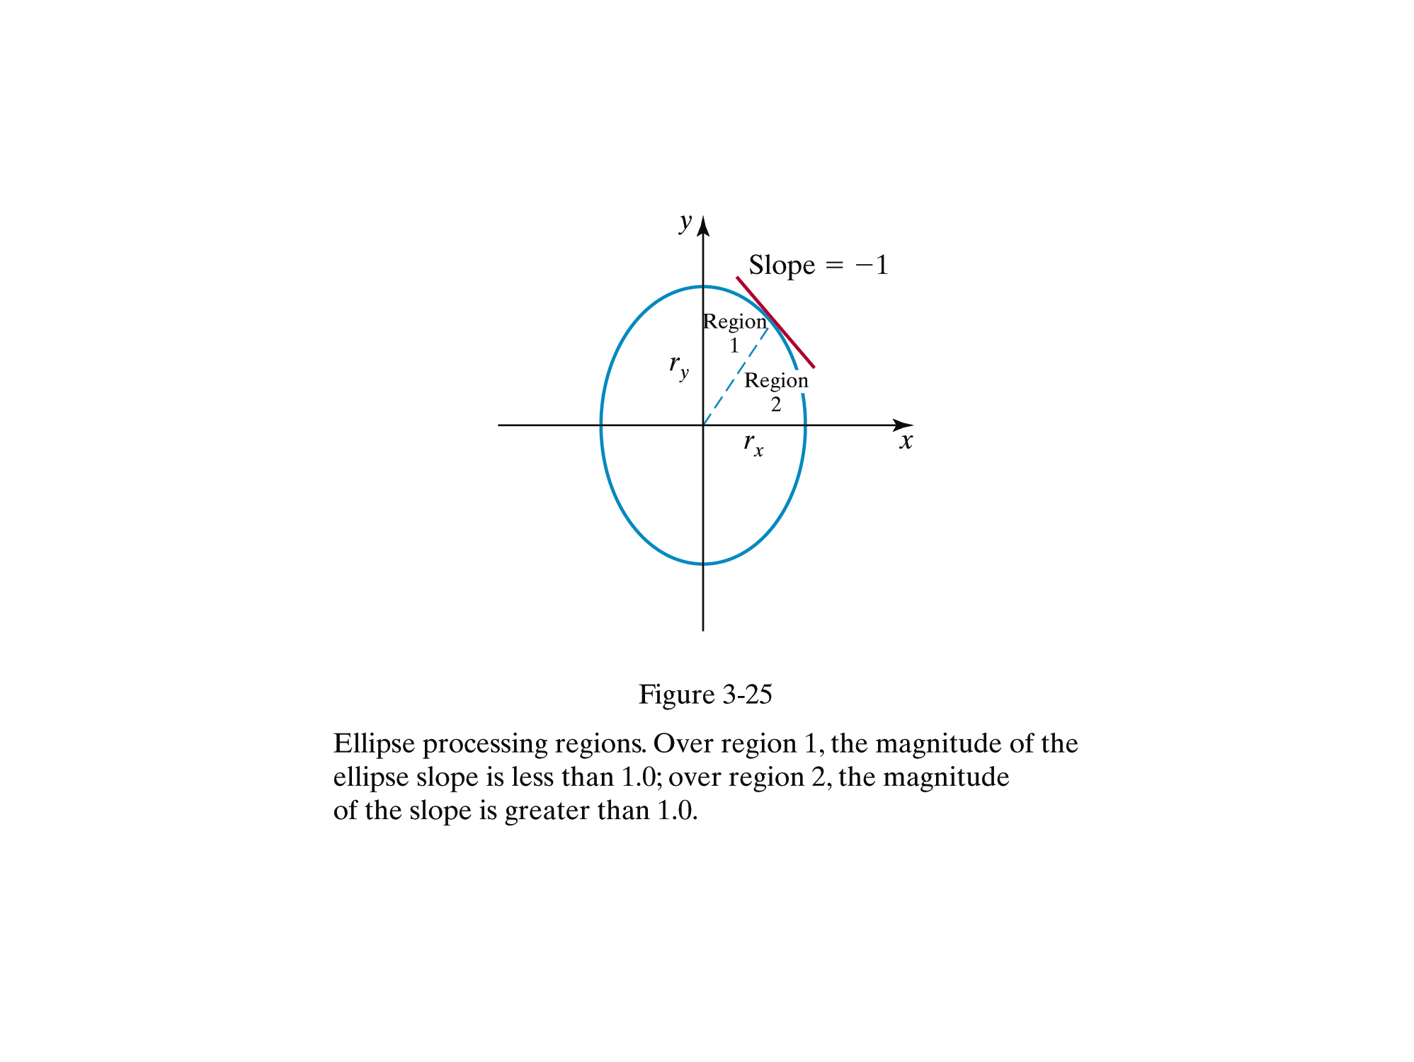

Slide 33
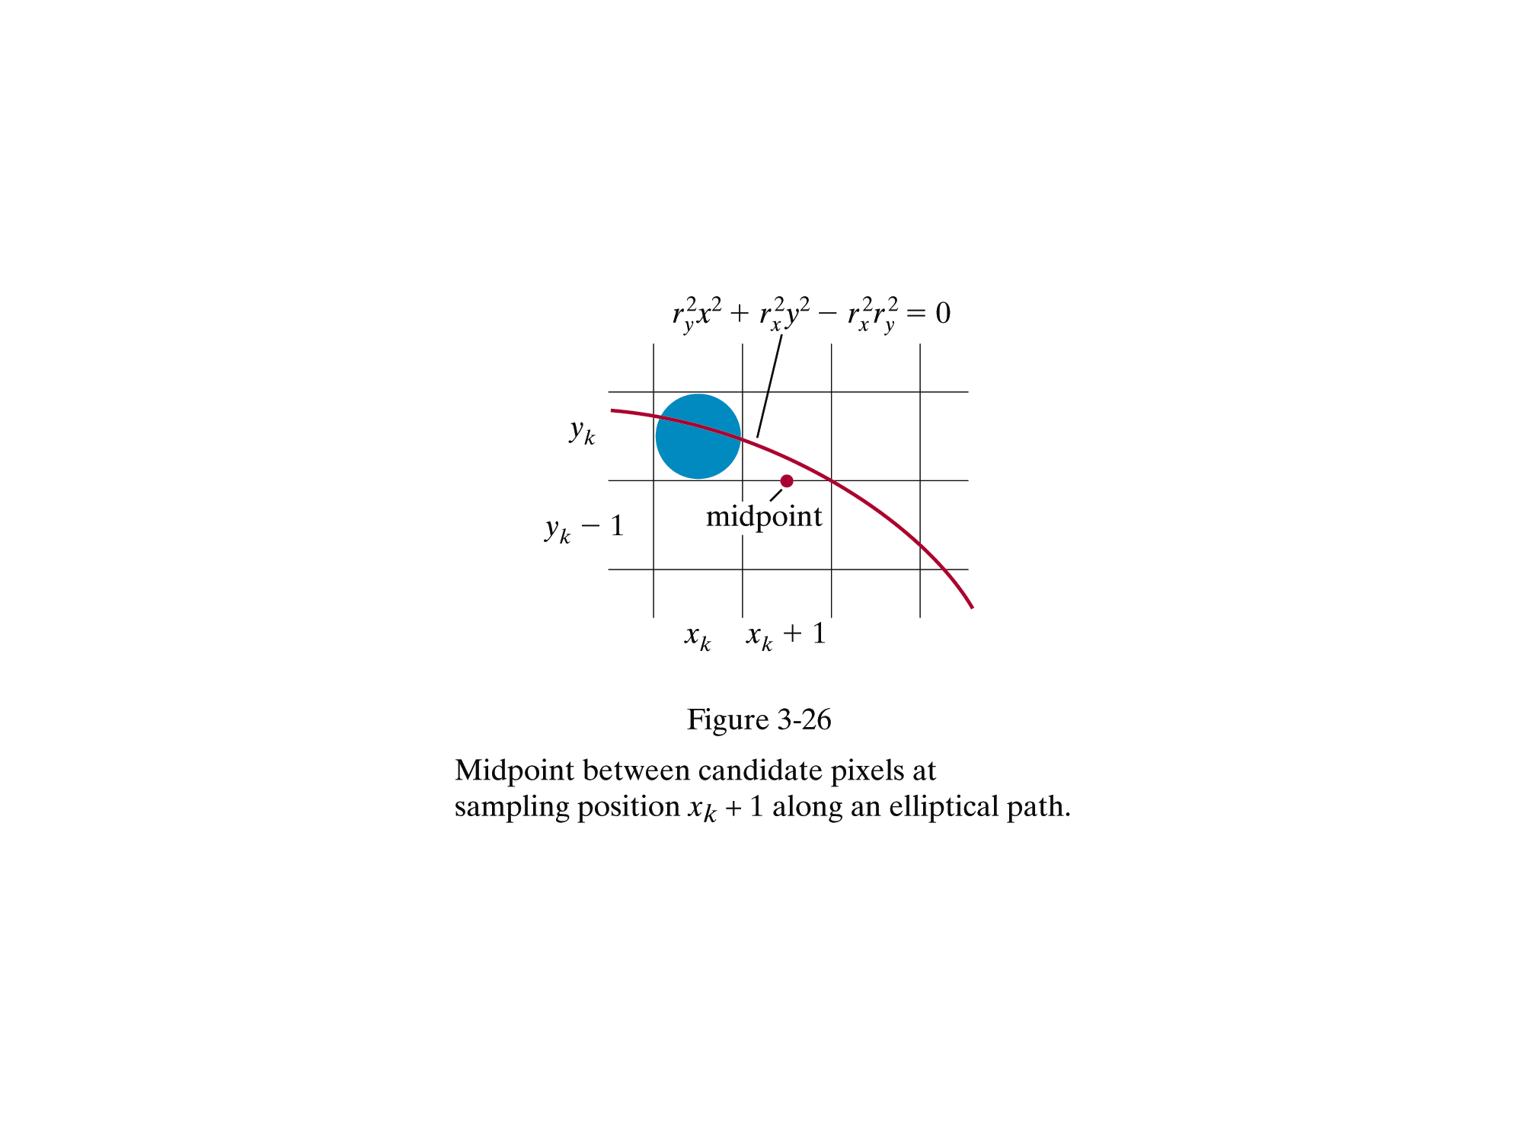

Slide 34
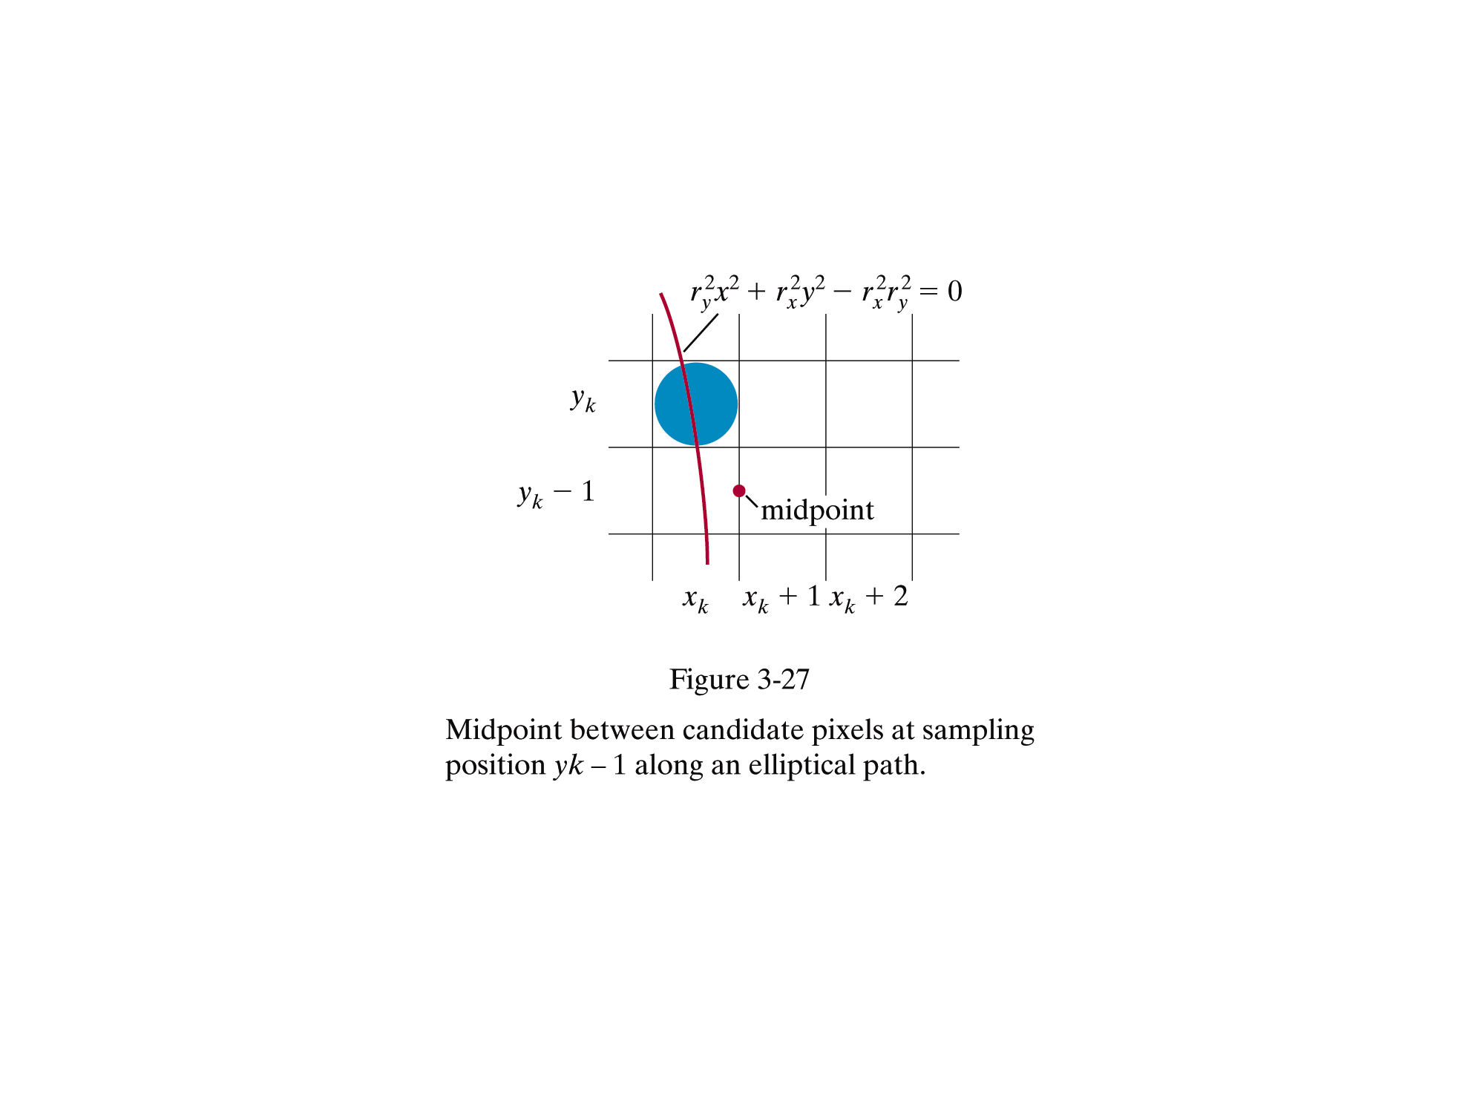

Slide 35
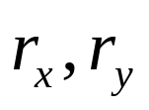

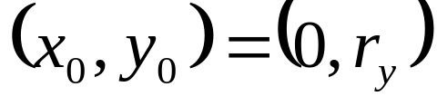
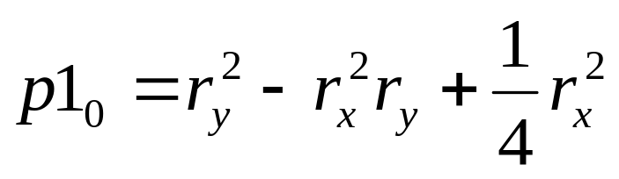
Midpoint Ellipse Algorithm
Input and ellipse center and obtain the first point on an ellipse centered on the origin as
Calculate the initial value of the decision parameter in region 1 as

Slide 36



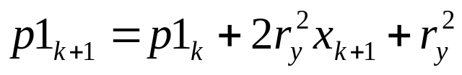



Midpoint Ellipse..
At each position in region 1, starting at k = 0, perform the following test. if , the next point along the ellipse centered on (0,0) is and
Otherwise, the next point along the ellipse is and
with
and continue until

Slide 37
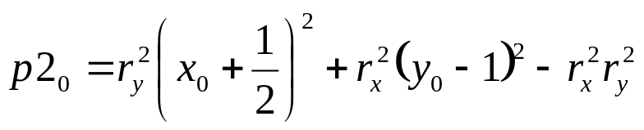






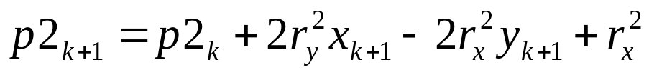
Midpoint Ellipse Contd.
Calculate the initial value of the decision parameter in region 2 as
where is the last position calculated in region 1
At each position in region 2, starting at k=0, perform the following test. if , the next point along the ellipse centered on (0,0) is and
Otherwise, the next point along the ellipse is and
Using the same incremental calculations for x and y as in region 1. Continue until y=0

Slide 38

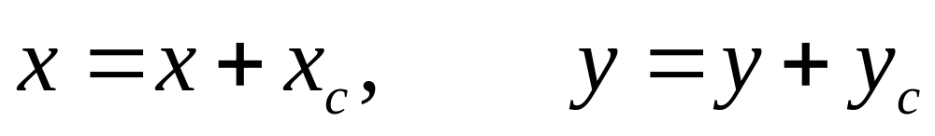
Midpoint Ellipse
For both regions, determine symmetry points in the other three quadrants
Move each calculated pixel position (x, y) onto the elliptical path that is centered on and plot the coordinate values

